Slide 1








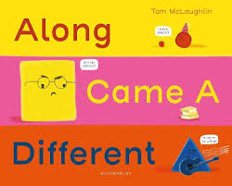






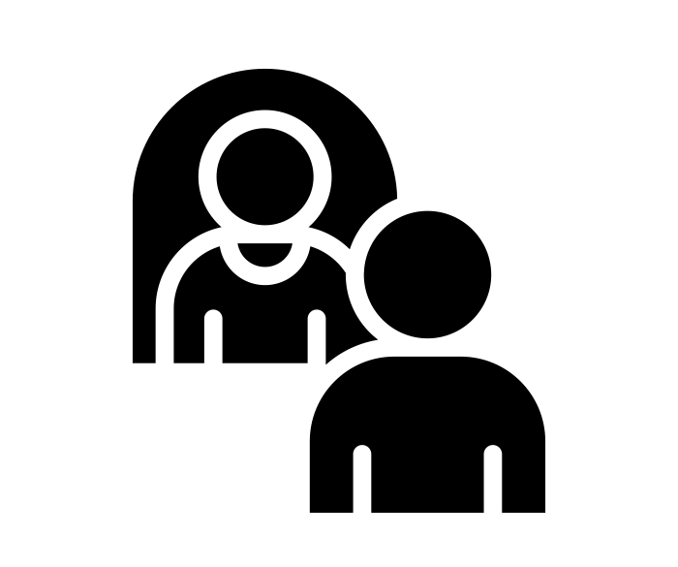


Pre-School | Autumn Term
Bravery Citizenship Curiosity Gratitude Integrity Kindness

Slide 2




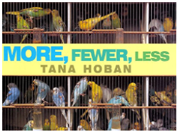

Pre-School | Autumn Term – SUPPORTING BOOKSHELF
Bravery Citizenship Curiosity Gratitude Integrity Kindness

