Slide 1













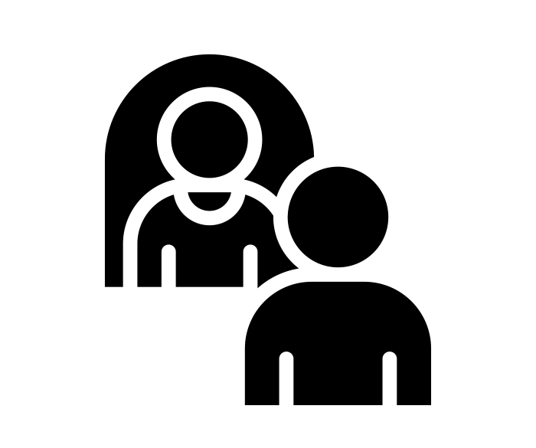


Year 2 | Autumn Term
Bravery Citizenship Curiosity Gratitude Integrity Kindness

