Slide 1















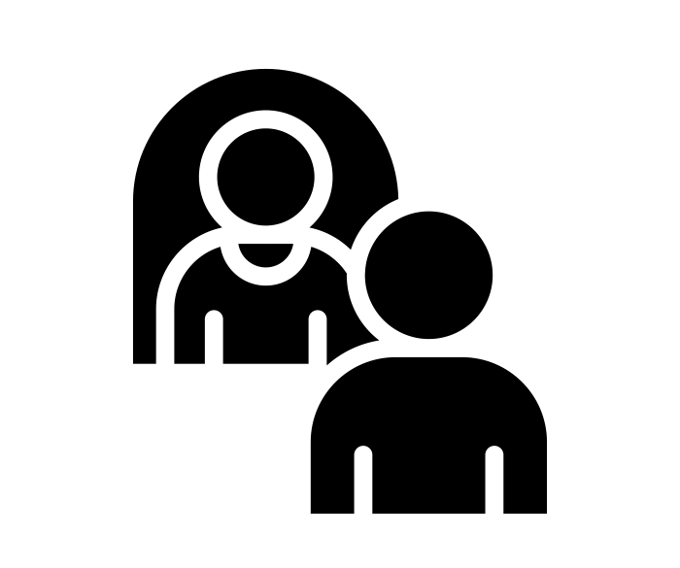


Reception | Spring Term
Bravery Citizenship Curiosity Gratitude Integrity Kindness

