Slide 1
















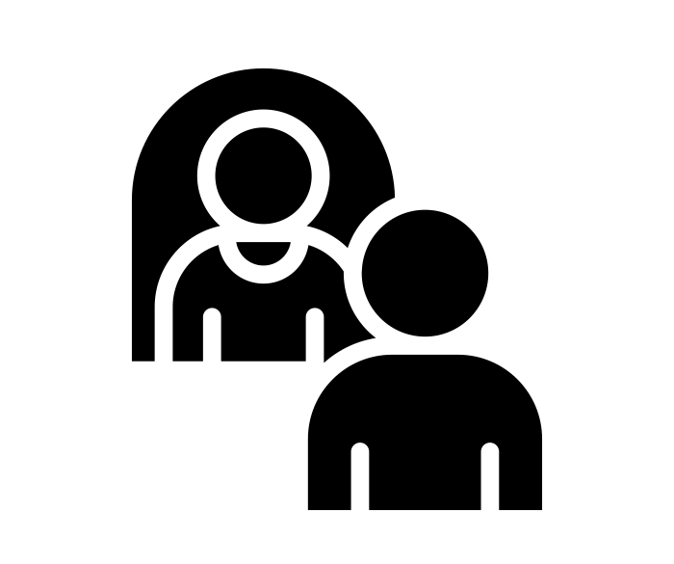
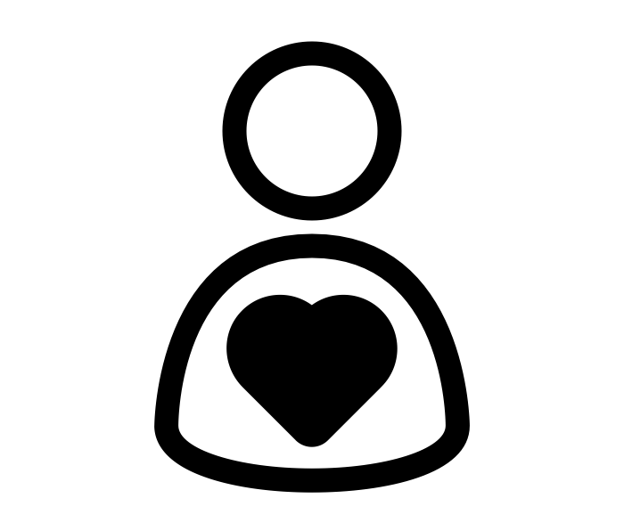


Year 2 | Spring Term
Bravery Citizenship Curiosity Gratitude Integrity Kindness

